Slide 1
Fall 2021 Pre-calculus
Lesson 5.2
Dr. O’Brien
Lehman High School
October 18th, 2021
Notes:
students need calculators
no new vocab

Slide 2

do now
be sure to: Get out your binder. Copy goal and answer do now questions below. Show all work or write a complete sentence for each answer:
Read through the how to solve it method.
What is the most difficult part of the method to do? Answer in a complete sentence.
how to solve it
Understand the problem:
Read the problem carefully.
What would a sensible final answer look like (number, equation, sentence, etc.)?
Make a plan:
Come up with a strategy to solve a problem
What formulas/math skills will you need?
Execute the plan:
Work through your strategy step by step
Review your work:
Does your answer make sense?
If not go back to (2). Do it again!!
Notes:
+answers will vary. Make a plan can be hard, if you don’t know where to start. (4) can also be hard, since people want to do as little work as possible.
+Why is it a good idea to understand the problem and then make a plan? because otherwise we don’t know what we’re doing!
+How do you start making a plan? Think about what you already know, and about how this problem resembles problems you’ve seen before.

Slide 3
framing
what: Use how to solve it to solve complex word problems
why: This will help us break down difficult problems into smaller parts so we can apply our fundamental math skills!
where to: Fun with polynomial functions
Notes:
the plan: We’ll go through one of the Pset #5 word problems together.
You’ll work with a partner to solve some other word problems

Slide 4
Understand the problem:
What information are we given?
What would a sensible answer look like?
A pebble is dropped into a calm pond, causing ripples in the form of concentric circles. The radius (in feet) of the outermost ripple is given by r$r(t)=0.6t$, where t is the time (in seconds) after the pebble strikes the water. The area of the circle is given by $A(r)=πrt^{2}$. Find the radius of the largest circle after 1.3 seconds.
Notes:
A pebble is dropped in the pond. The ripples are ‘concentric’ circles. r(t) = 0.6t. A(r) = pi*rt^2.
A sensible answer would be a real number. +What could be an interval for this number? +Do we think the answer will be negative? no because all the numbers here are positive +will the answer be bigger than 10? hard to know but 1.3 is pretty small so probably not so we know that the answer is probably somewhere between 0 and 10

Slide 5
Make a plan:
How does this problem resembles problems we’ve already seen?
What would be a good first step?
A pebble is dropped into a calm pond, causing ripples in the form of concentric circles. The radius (in feet) of the outermost ripple is given by r$r(t)=0.6t$, where t is the time (in seconds) after the pebble strikes the water. The area of the circle is given by $A(r)=πrt^{2}$. Find the radius of the largest circle after 1.3 seconds.
Notes:
It resembles problems involving combinations of functions. In this case, it’s specifically composite functions, because the radius goes into the area.
A good first step could be finding the composite of A and r. +How do we know whether to compose A with r or r with A? It’s A with r because the input for A is a radius, which is the output for r.

Slide 6
Execute your plan
Review your work
A pebble is dropped into a calm pond, causing ripples in the form of concentric circles. The radius (in feet) of the outermost ripple is given by r$r(t)=0.6t$, where t is the time (in seconds) after the pebble strikes the water. The area of the circle is given by $A(r)=πrt^{2}$. Find the radius of the largest circle after 1.3 seconds.
Notes:
WORK THROUGH ON BOARD
r(t) = 0.6t
A(r) = pi r t^2
(A . r)(t) = A(r(t)) =
pi (0.6 t)t^2 = 0.6 pi t^3
We could appoximate the coefficient by multiplying 0.6 with pi, but right now I want to keep things as simple and accurate as possible.
Final step. plug t = 1.3
0.6 pi (1.3)^3 = 4.14
review work.
Go through our calculations. +Do we see any mistakes? maybe! it depends on if I do something wrong here.
+does this answer make sense, yes it’s bigger than 0 and less than 10. So this seems like a reasonable answer!

Slide 7
activity
activity
be sure to: Work with one (!) neighbor (someone right next to you!). Answer the questions below for each problem.
Understand the problem! What question are you answering and what would be a reasonable answer?
Make a plan! What combination of function will you use?
Execute plan! Show all your work
Review your plan Does your answer make sense? How can you solve it better?
Notes:
+How do I make a plan? Make sure you understand the question, then think about which combination of functions will make sense here.
+ how do I know if my answer is correct? Maybe check in with another group. If there ’s a difference you can talk about what you did differently.

Slide 8
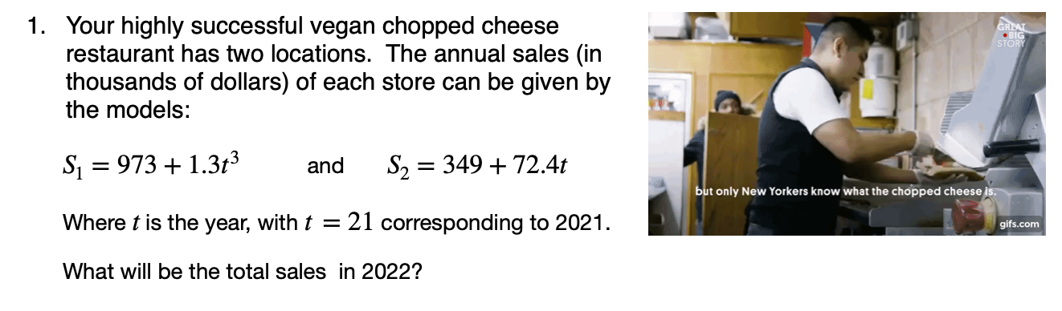
Notes:
See answer key.

Slide 9
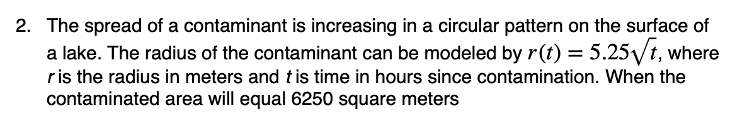

Slide 10
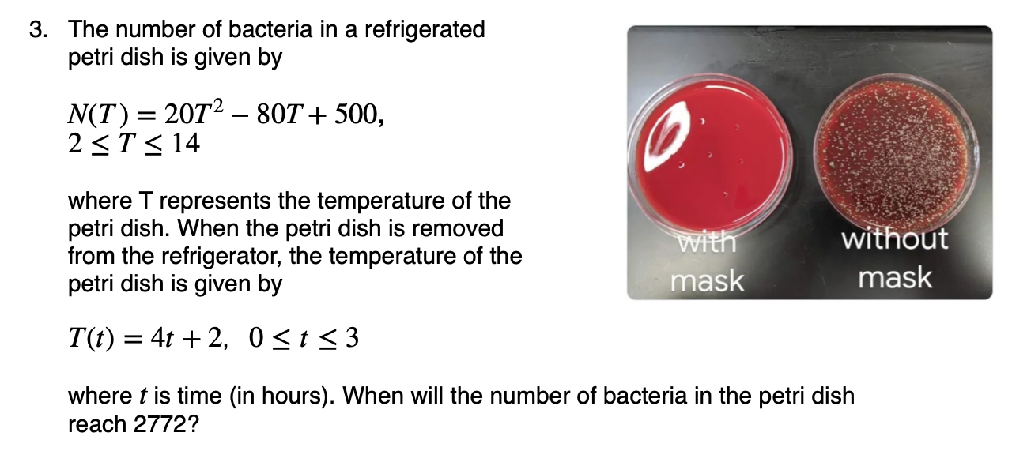

Slide 11
d
Reflection
How was using the how to solve it method helpful?
What was most challenging about the method?
Do you feel like you’re more prepared to solve word problems in the future? Why or why not?
Before we go: Please arrange desks in rows!!
Notes:
apply box method = -4x^3+4x^2 -2x + 3.
5. N.T(t) = 20(4t+2)^2 -80(4t+2) + 500 =
20(4t+2)[4t+2 - 4]
20(4t+2)(4t-2) + 500=
20[4t^2 -4] + 500 = 2000
1500/20 = 4t^2 - 4
79 = 4t^2
t = sqrt(79)/2
+is this in the domain of our function? no its about 4.44. so the bacteria count will never reach 2000.

